Slide 1
The Git SuperDeck
By Matthew Townsend
NCS Club President

Slide 2
Let’s Git - going
Installation
Terminal - setup, GUI Set-up
Branches
Operations
Rebase
Merging Conflicts
Github

Slide 3
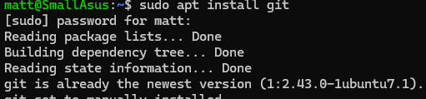
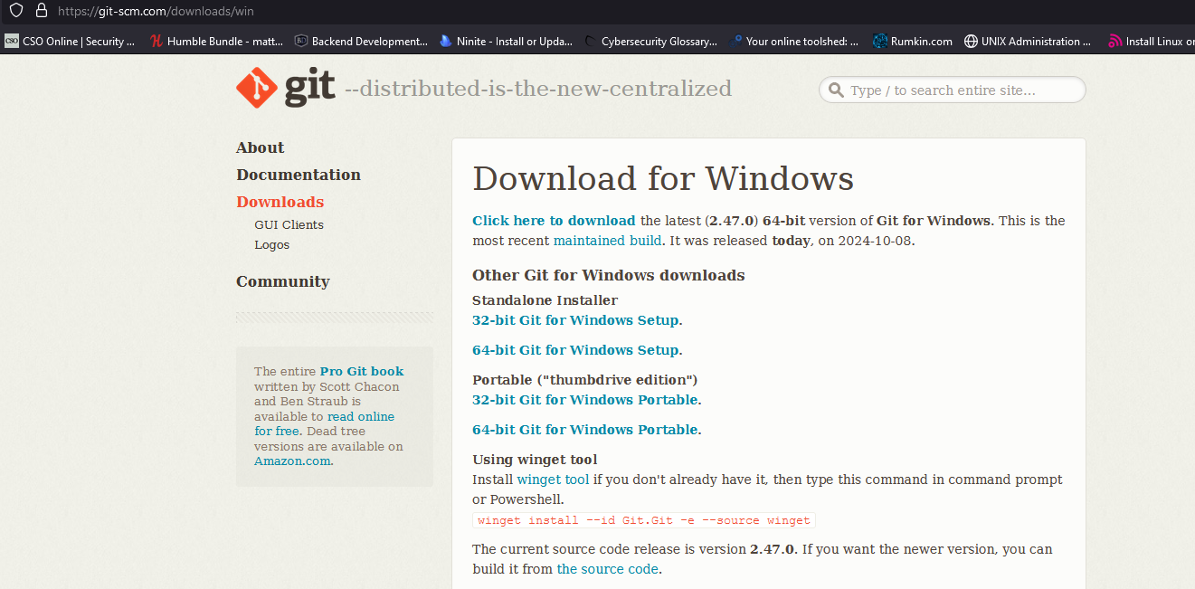
Installation
Linux
‘Package-manager’ install git
Windows
Navigate to https://git-scm.com/downloads
Select windows, 64 bit desktop, run executable hit next or yes for popups.

Slide 4
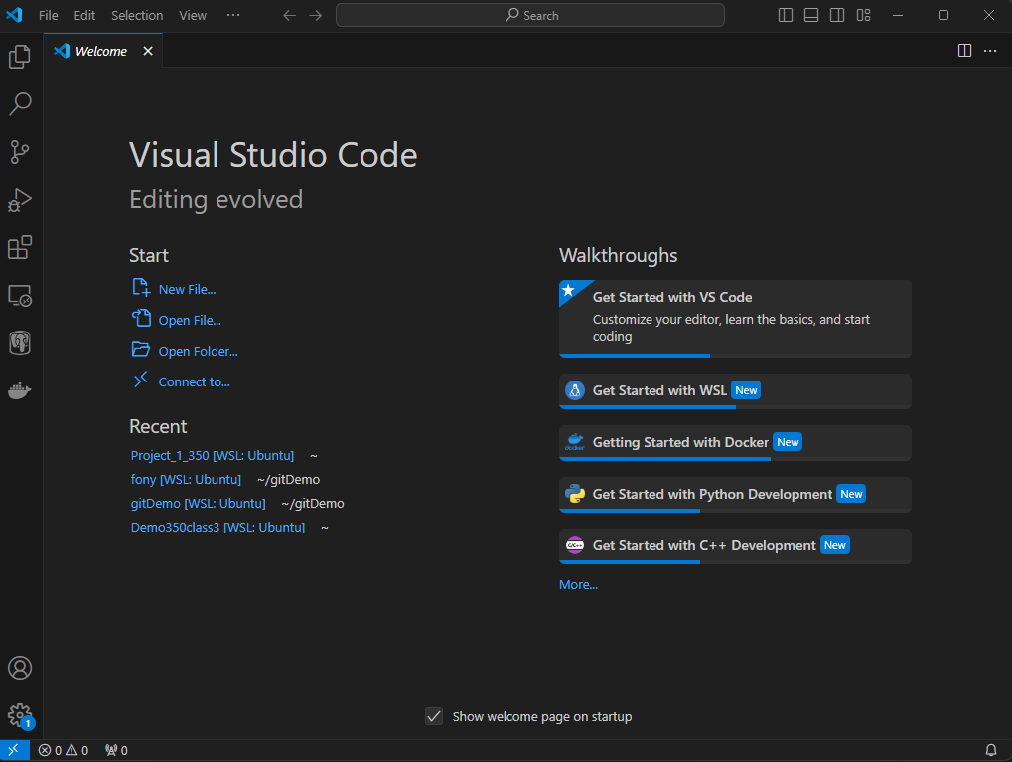
Visual Studio Code
For using git in a code editor, this slide deck will depict the git actions within VScode.
Install using a package manager

Slide 5
To the CLI

Slide 6

Creating your first repository
**Establish git identity
git config –global user.name “github username”
git config –global user.email = “github email”
**Create a New Directory, all files will be tracked and saved
mkdir gitDemo
**The directory is now a repository

Slide 7
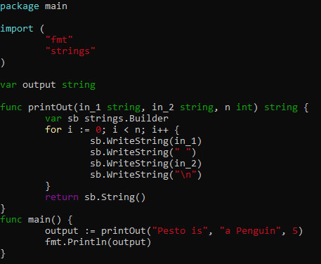
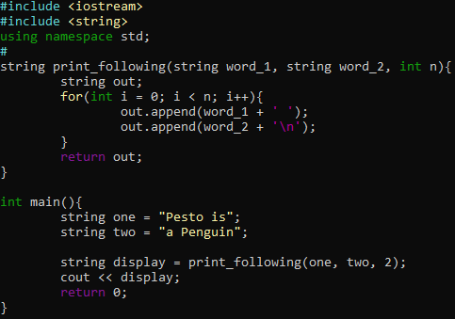
Create your files
Use any text editor to create your files.

Slide 8

Git status
This command will appear often in the slidedeck, it is used to view the current state of the repository/branch you are on. Committed files, uncommitted files, conflicts, etc.

Slide 9
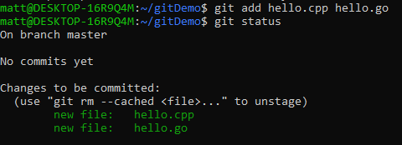
Adding files
In git adding files means tracking the contents of the files.

Slide 10

Commit -m
The next operation is commit, this saves the version of the file at time of command, any modifications done after commit will not be included when somebody pulls from repo.

Slide 11

Pull
The pull command “pulls” any missing data from the main repository, for example one being hosted on github.
This can be done with additional options if you need to pull from an upstream repo.

Slide 12


Branches
In git, the most useful feature is branches, it allows for multiple individuals to work on the code in the repo simultaneously, then merge/rebase at the end.
To start, check branch
Then create a new branch

Slide 13

Branches - 2
To visit the created branch
From here you can edit, add, commit files, but be careful of modifying existing code.

Slide 14
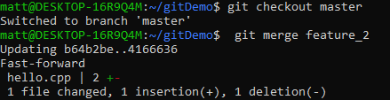
Merge
Merging is when you combine branches, this is most common with adding the features of a branch onto the master/head branch.
If there is no conflicts in the merging content, then it will be successful.

Slide 15

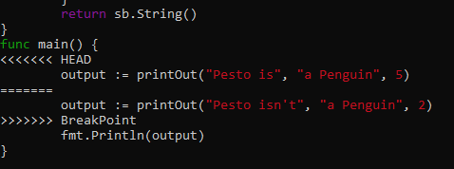
Merge Conflict
Merge Conflict is when there are different versions of the same file.

Slide 16
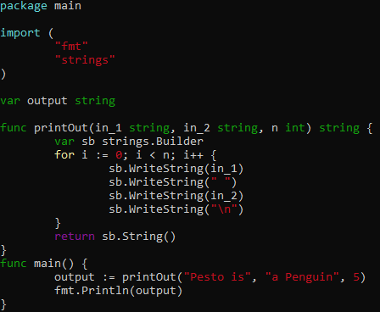

Merge Conflict Resolution
To resolve the conflict, pick which version of code you want and delete other version/ git text in file.

Slide 17
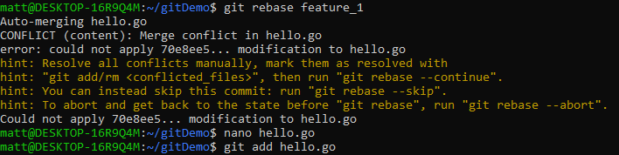
Rebase
Rebase - adds the commit history and content to repo - also susceptible to conflict

Slide 18
.gitignore
The gitignore file is a special file that git checks before committing files, to ensure that anything listed with the gitignore is not in the commit.
Adding .env files can be helpful to prevent accidental pushing of api keys.

Slide 19
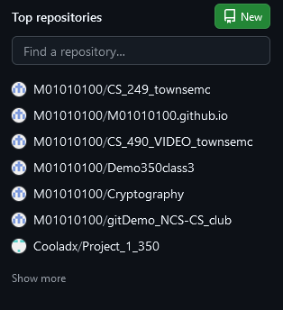
Github
Navigate to https://github.com/ and press sign up and go through menus
From there you will see the dashboard for github
On the left there are current repositories
This is where the repo will appear

Slide 20
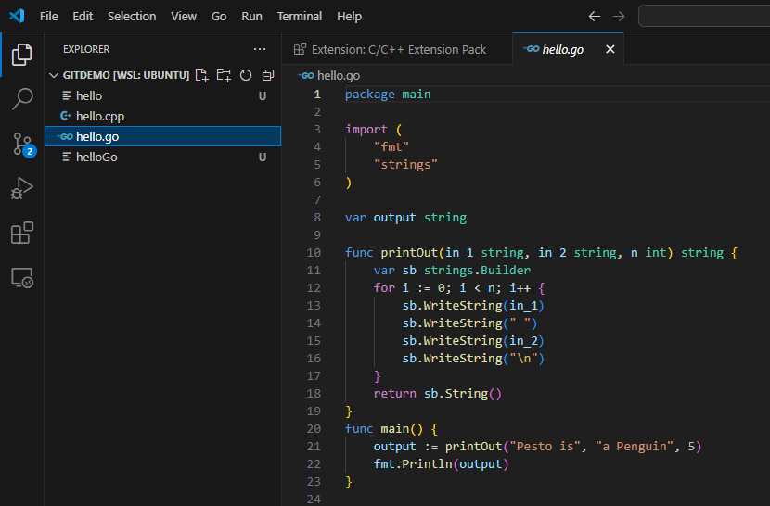
Pushing - vscode
View >> command pallet >> git publish >> open in web browser
(ctrl+shift+p) >> git publish >> web browser (or use ssh keys to do so through CLI)

Slide 21
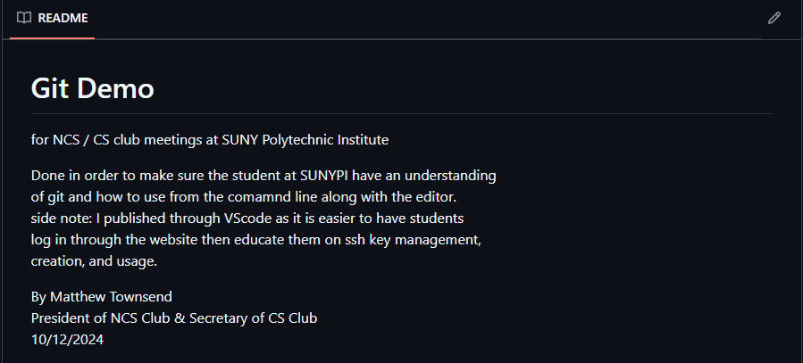
Readme
On github if you press on the repo it will ask if you want to create a readme file
This is a simple text file that github will display where you can explain the code/project in detail.

Slide 22
title
text

